Slide 1


Alejandro Enriquez
Sept. 5th, 2023

Slide 2

Outline
Executive Summary
Introduction
Methodology
Results
Conclusion
Appendix

Slide 3
Executive Summary
Methodologies:
-Data Collection using SpaceX API and Web Scraping
-Data Wrangling
-Exploratory Data Analysis using SQL
-Data Vizualization Using Python Pandas and Matplotlib
-Analysis with Folium-Interactive Visual Analytics and Ploty Dash
-Machine Learning Landing Prediction
Results
-Exploratory Data Analysis Results
-Visual Analytics and Dashboards
-Predictive Analysis(Classification)

Slide 4
Introduction
Background
Problem
Space X advertises Falcon 9 rocket launches on its website with a cost of 62 million dollars; other providers cost upward of 165 million dollars each, much of the savings is because Space X can reuse the first stage. Therefore if we can determine if the first stage will land, we can determine the cost of a launch. This information can be used if an alternate company wants to bid against space X for a rocket launch.
To predict if the Falcon 9 first stage will land successfully by using the data from Falcon 9 launches available in its website.

Slide 5

Section 1

Slide 6
Methodology
Executive Summary
Data collection methodology:
Describe how data was collected
Perform data wrangling
Describe how data was processed
Perform exploratory data analysis (EDA) using visualization and SQL
Perform interactive visual analytics using Folium and Plotly Dash
Perform predictive analysis using classification models
How to build, tune, evaluate classification models

Slide 7
Data Collection
How data sets were collected.
- Get request to the SpaceX API and then perform some basic data wrangling and formatting.
- web scraping with BeautifulSoup to collect Falcon 9 historical launch records from a Wikipedia page titled List of Falcon 9 and Falcon Heavy launches

Slide 8
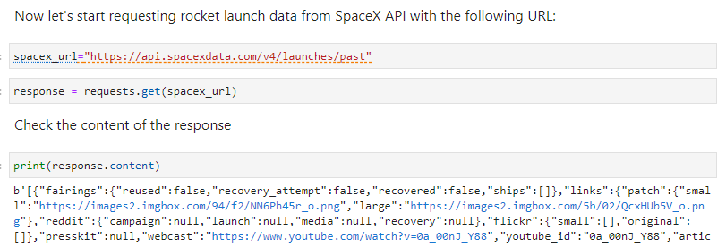
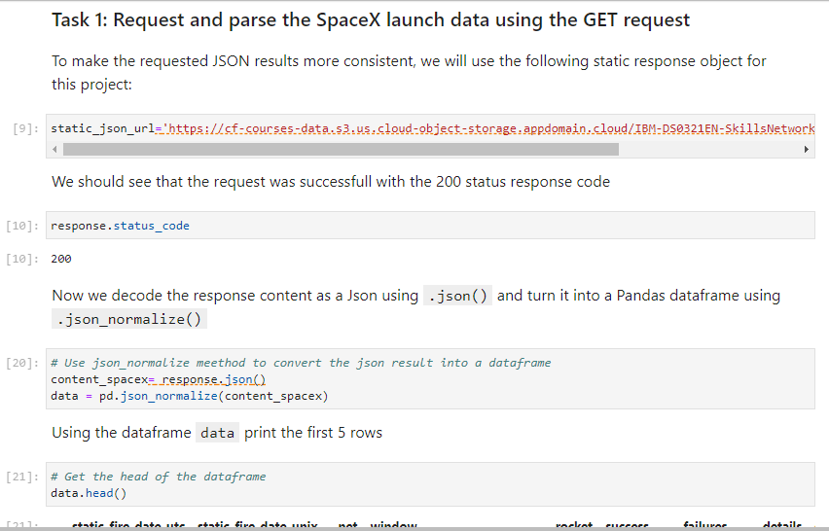
Data Collection – SpaceX API
Data collected using SpaceX API by making a get request to the SpaceX API then transform the response content as a Json to then turn it into a Pandas dataframe.
Github URL: https://github.com/Alejandro-ER/ibm_capstone_project/blob/main/IBM_1_spacex-data-collection-api_AlejandroEnriquez.ipynb

Slide 9
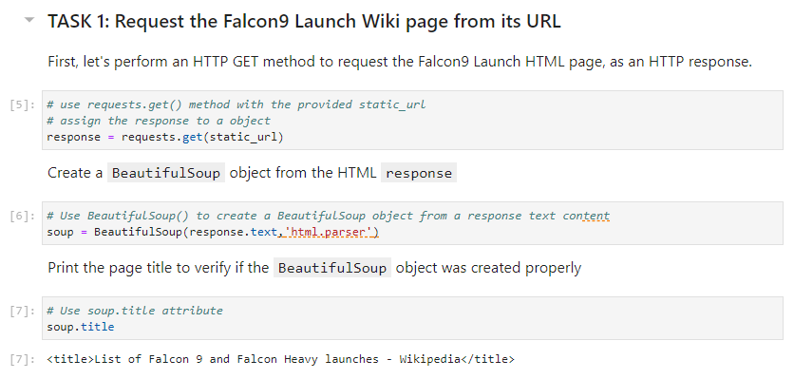
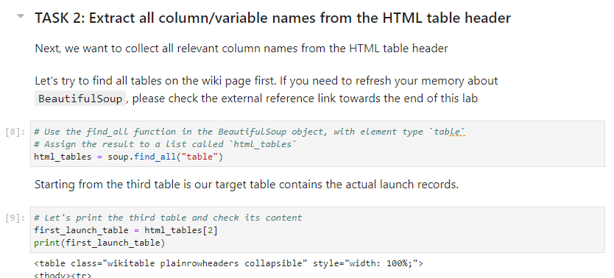
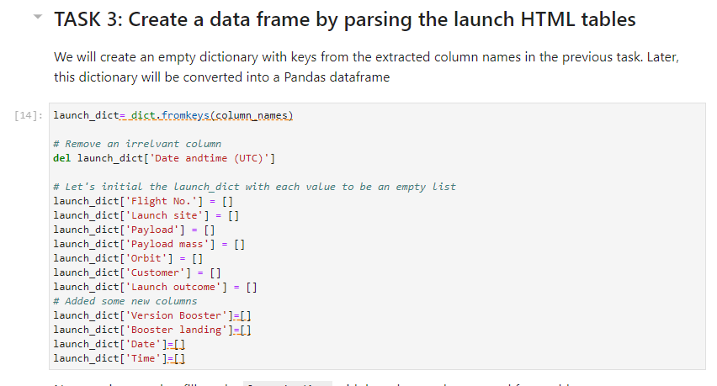
Data Collection - Scraping
Web Scraping: collected Falcon 9 historical launch records from a Wikipedia with BeautifulSoup and request. Falcon 9 launch records were extracted from an HTML table of the Wikipedia page. After parsing, a pandas DataFrame was created.
Github URL: https://github.com/Alejandro-ER/ibm_capstone_project/blob/main/IBM_2_spacex-labs-webscraping_AlejandroEnriquez.ipynb
Place your flowchart of web scraping here

Slide 10
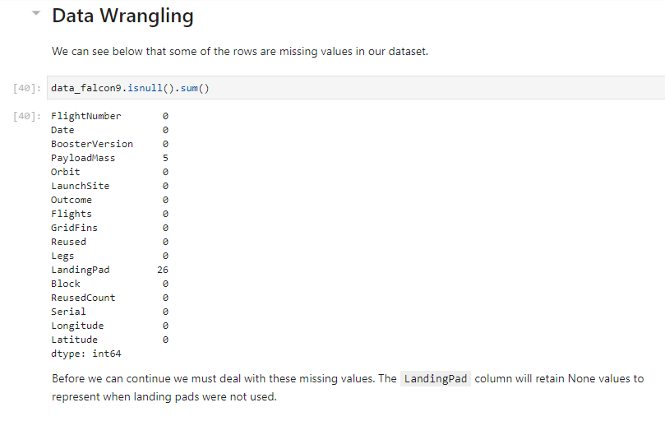
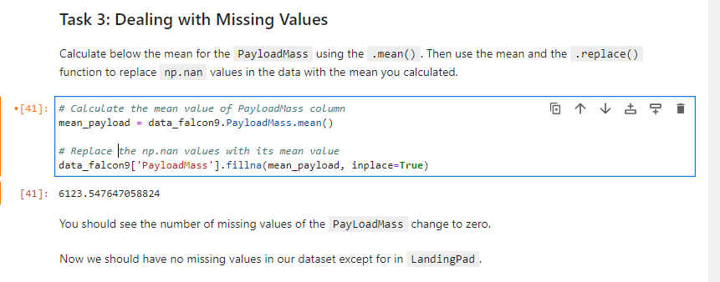
Data Wrangling
After collecting the data with web scrapping, a check was performed to ensure there were no missing values in key variables, such as PayloadMass. Missing values were then replaced with the mean of PayloadMass.
GitHub URL: https://github.com/Alejandro-ER/ibm_capstone_project/blob/main/IBM_3_spacex-data_wrangling_AlejandroEnriquez.ipynb

Slide 11
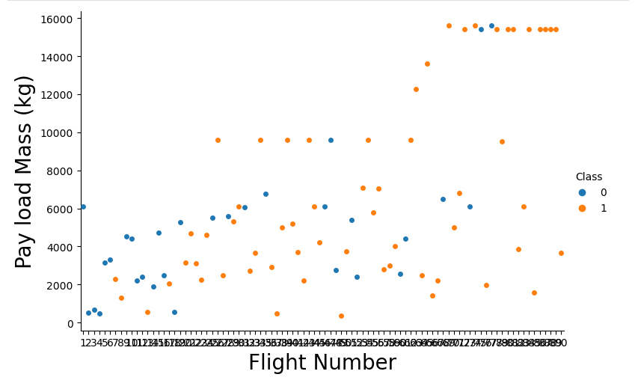
EDA with Data Visualization (1/5)
We can plot out the FlightNumber vs. PayloadMassand overlay the outcome of the launch. We see that as the flight number increases, the first stage is more likely to land successfully. The payload mass is also important; it seems the more massive the payload, the less likely the first stage will return.
GITHUB address: https://github.com/Alejandro-ER/ibm_capstone_project/blob/main/IBM_5_spacex_EDA_DataVizualization_AlejandroEnriquez.ipynb

Slide 12
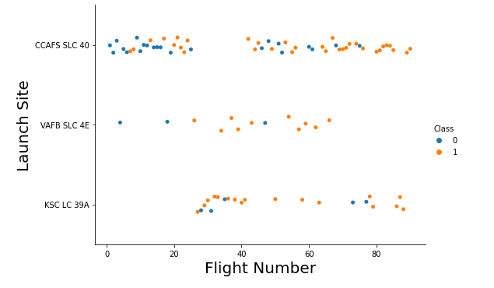
EDA with Data Visualization (2/5)
The graph below shows there is a relationship between launch sites and successful landing. Data shows that site CCAFS SLC 40 has more successful launches with greater flight numbers. And for medium range flight number, it is evident that the other two launch sites see a success rate.

Slide 13
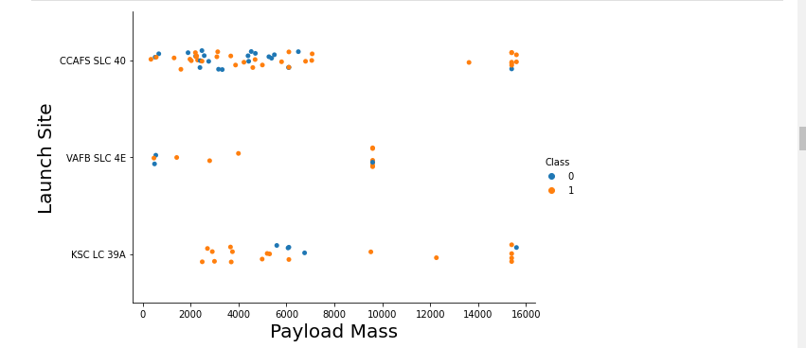
EDA with Data Visualization (3/5)
The graph shows the relationship between Payload Mass vs Launch Site, it is evident that for site VAFB SLC there are no heavy payload Mass launches. Site CCAFS SLC 40 shows an evenly rate with lighter Payload Mass launches while site KSC LC shows greater success with lighter Payload Mass launches.

Slide 14
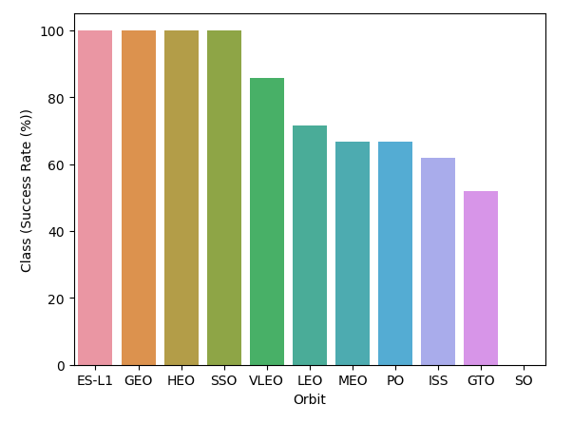
EDA with Data Visualization (4/5)
The graph displays the success rate for the landings coming from different orbits, as t is evident: ES-L1, GEO, HEO and SSO have a 100% success rate.

Slide 15
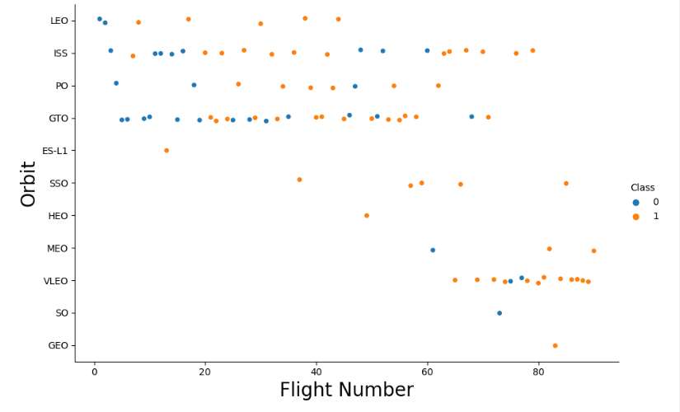
EDA with Data Visualization (5/5)
This graph illustrates the number of flights per orbit, it is clear that the success rate from the previous graph obeyed to just a single landing from orbits ES-L1, HEO, and GEO. Orbit SSO has 5 successful landings, the same as orbit ISS.

Slide 16
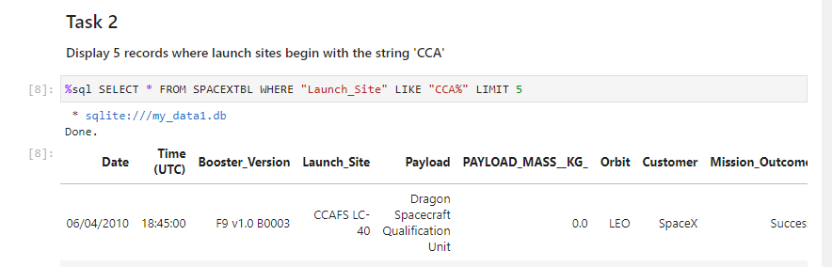
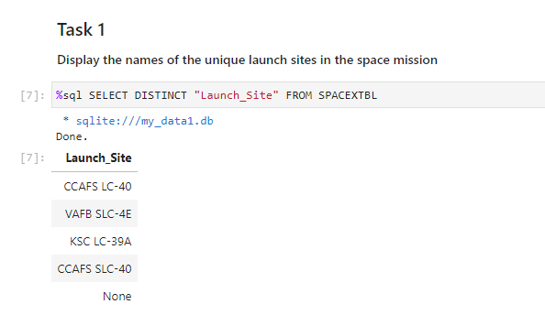
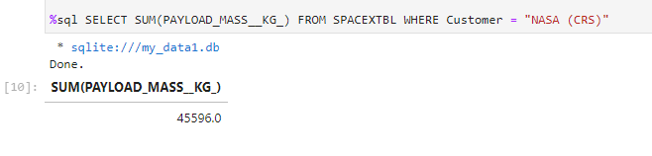
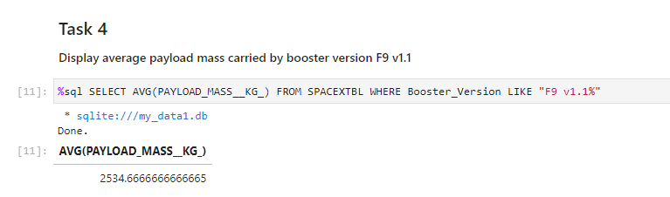
EDA with SQL (1/4)
The following are a series of SQL queries performed for an exploratory Data Analysis using SQL on a Jupyter Notebook.

Slide 17
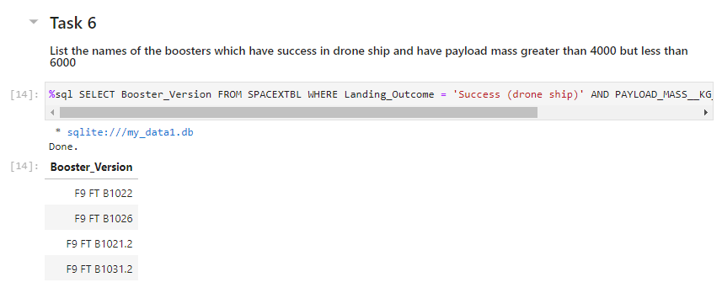
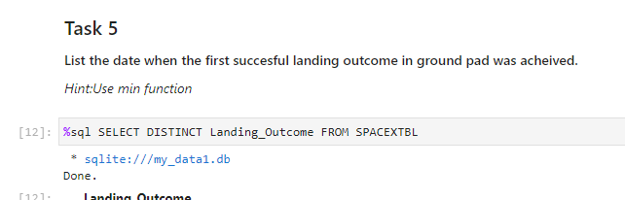
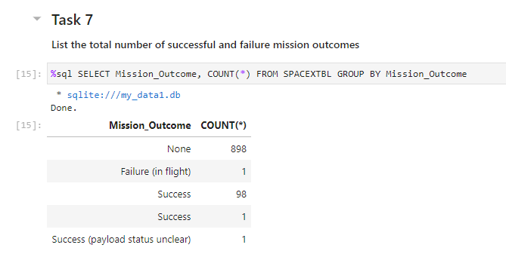
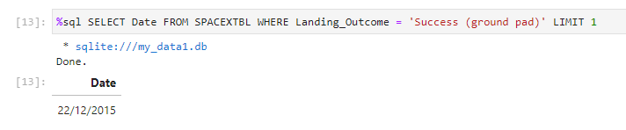
EDA with SQL (2/4)
The following are a series of SQL queries performed for an exploratory Data Analysis using SQL on a Jupyter Notebook.

Slide 18
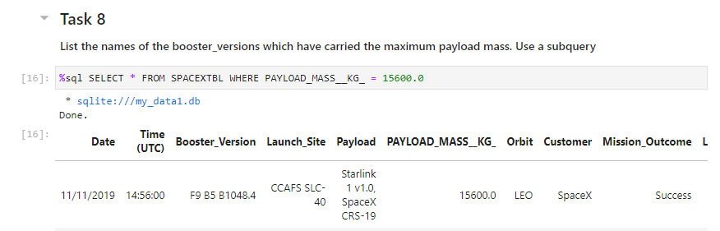
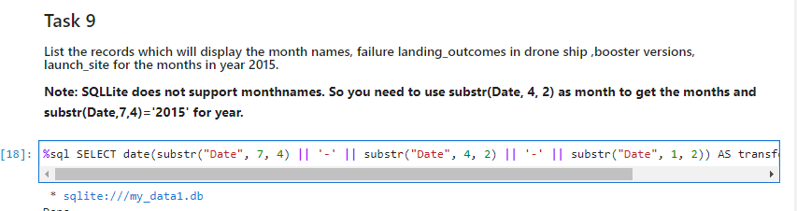
EDA with SQL (3/4)
The following are a series of SQL queries performed for an exploratory Data Analysis using SQL on a Jupyter Notebook.

Slide 19
EDA with SQL (4/4)
GitHub URL for this notebook:
https://github.com/Alejandro-ER/ibm_capstone_project/blob/main/IBM_4_spacex_sql_EDA_AlejandroEnriquez.ipynb

Slide 20
Build an Interactive Map with Folium
Created an interactive map using folium to visualize successful and unsuccessful launches for each launch sites. Color code was added (red=failure, green=success) for each launch. Circles were added to mark launch sites, as well as markers for each launch. Distance lines were also included. See illustrative pictures in the next slide.
GitHub URL:
https://github.com/Alejandro-ER/ibm_capstone_project/blob/main/IBM_6_spacex_InteractiveFoliumMap_AlejandroEnriquez.ipynb

Slide 21
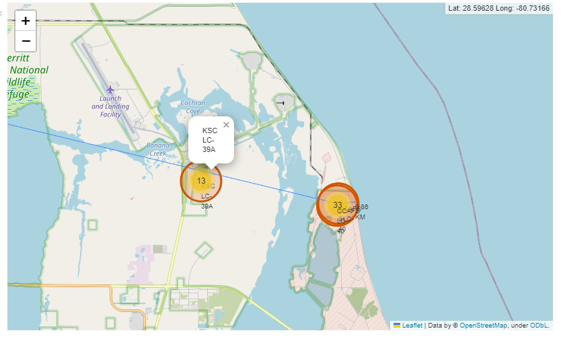
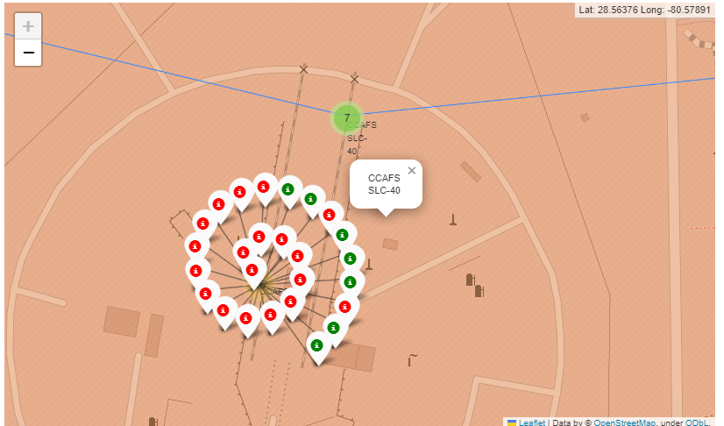
Build an Interactive Map with Folium

Slide 22
Build a Dashboard with Plotly Dash
The Plotly dashboard includes:
-Launch Site Drop-down Input Component
-A callback function to render success-pie-chart based on selected site dropdown
-A Range Slider to Select Payload
-A callback function to render the success-payload-scatter-chart scatter plot
GitHub URL:
https://github.com/Alejandro-ER/ibm_capstone_project/blob/main/IBM_7_spacex_BuildingInteractiveDashboard_AlejandroEnriquez.py

Slide 23
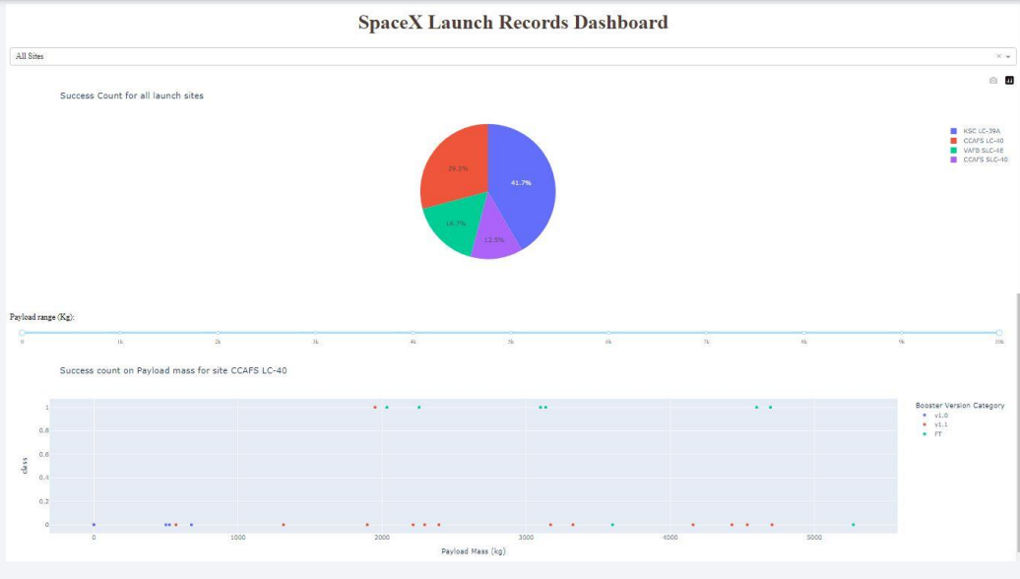
Build a Dashboard with Plotly Dash
Summarize what plots/graphs and interactions you have added to a dashboard
Explain why you added those plots and interactions
Add the GitHub URL of your completed Plotly Dash lab, as an external reference and peer-review purpose

Slide 24
Predictive Analysis (Classification)
Used the previous datasets to evaluate which machine learning model fits better. First a NumPy array was created from the "Class" column which predicts the success or failure of the landings and assign it to variable Y. After that, data was standarized using StandardScaler() and assign it to X. Data was split into X,Y Train and test sets. After splitting Logistic Regression, SVM, Decission Tree and KNN models were tested and got accuracy scores.
GitHub URL:
https://github.com/Alejandro-ER/ibm_capstone_project/blob/main/IBM_8_spacex_MachineLearningModels_AlejandroEnriquez.ipynb

Slide 25
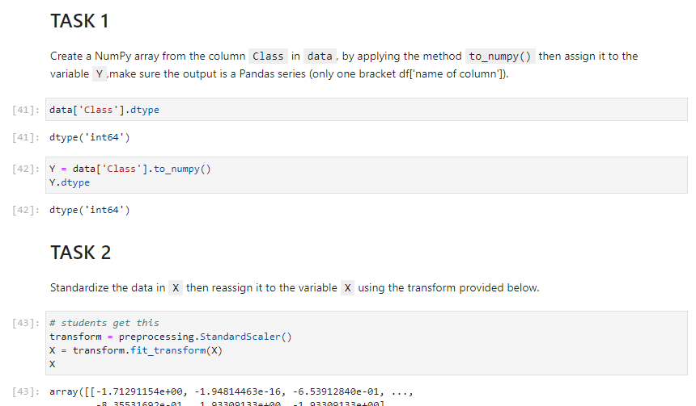
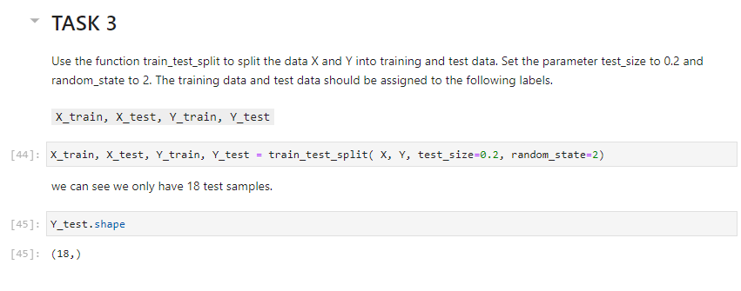
Predictive Analysis (Classification)

Slide 26
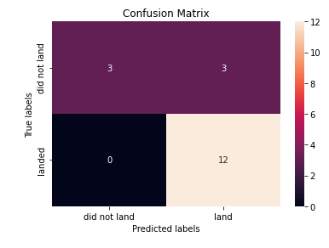
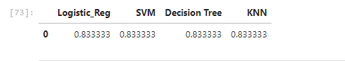
Results
Exploratory data analysis results (see previous slides)
Interactive analytics demo in screenshots (see previous slides for dashboards)
Predictive analysis results (accuracy for all models was 83.33%)

Slide 27

Section 2

Slide 28
Flight Number vs. Launch Site
The graph below shows there is a relationship between launch sites and successful landing. Data shows that site CCAFS SLC 40 has more successful launches with greater flight numbers. And for medium range flight number, it is evident that the other two launch sites see a success rate.

Slide 29
Payload vs. Launch Site
The graph shows the relationship between Payload Mass vs Launch Site, it is evident that for site VAFB SLC there are no heavy payload Mass launches. Site CCAFS SLC 40 shows an evenly rate with lighter Payload Mass launches while site KSC LC shows greater success with lighter Payload Mass launches.

Slide 30
Success Rate vs. Orbit Type
The graph displays the success rate for the landings coming from different orbits, as t is evident: ES-L1, GEO, HEO and SSO have a 100% success rate.

Slide 31
Flight Number vs. Orbit Type
This graph illustrates the number of flights per orbit, it is clear that the success rate from the previous graph obeyed to just a single landing from orbits ES-L1, HEO, and GEO. Orbit SSO has 5 successful landings, the same as orbit ISS.

Slide 32
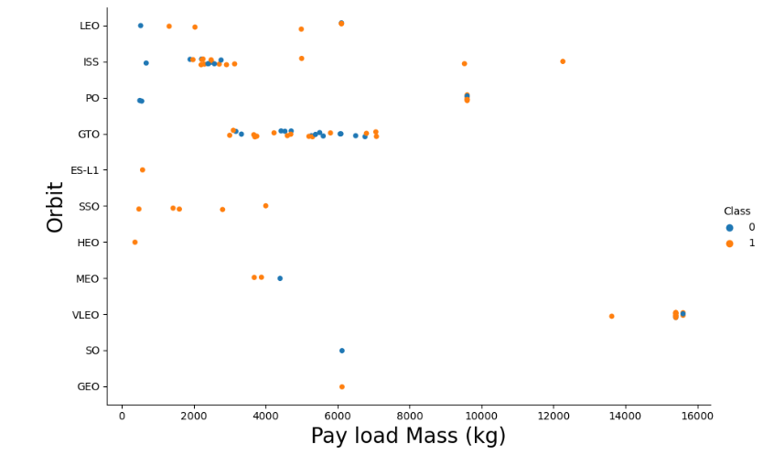
Payload vs. Orbit Type
The graph displays a relationship between Pay Load Mass and the different orbits, labeled by the success Class, 0 for failure, 1 for success. It I clear that Orbit SSO with lower Pay Load Mass has greater success rate.

Slide 33
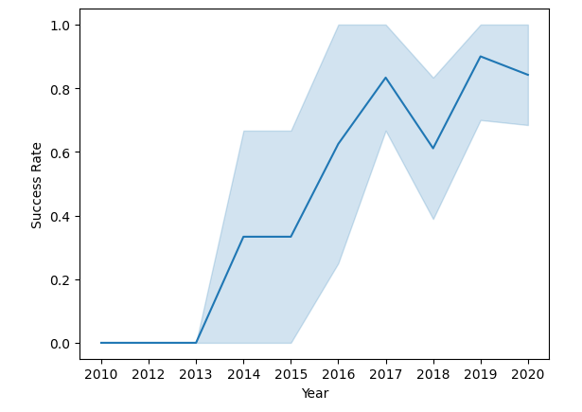
Launch Success Yearly Trend
This lines shows the relationship between success rate and years. It is evidente that as years go by, success rates increases.

Slide 34
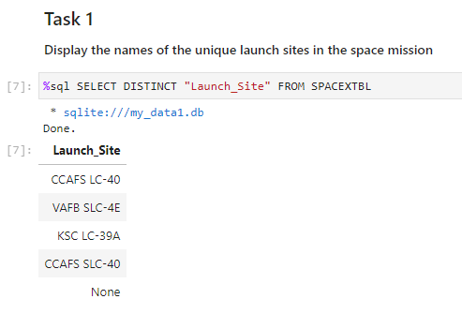
All Launch Site Names
SQL to find the different launch sites using DISTINCT.

Slide 35
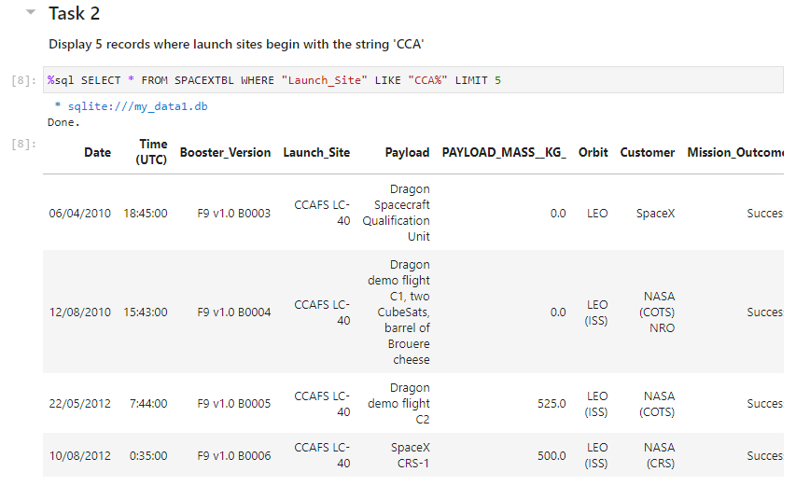
Launch Site Names Begin with 'CCA'
SQL to find launch sites that start with “CCA”. Key element in the query is ‘ LIKE “CCA%” ‘

Slide 36
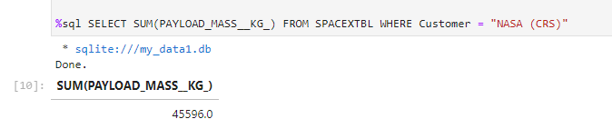
Total Payload Mass
Calculate the total payload carried by boosters from NASA
The SQL query shows the total sum of the Payload Mass where customer is NASA.

Slide 37
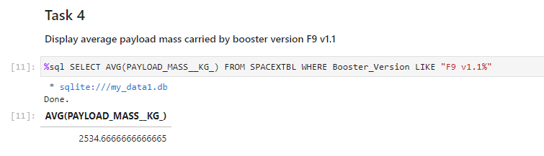
Average Payload Mass by F9 v1.1
SQL query to find the average Payload Mass on a selected Falcon 9 booster versión.

Slide 38
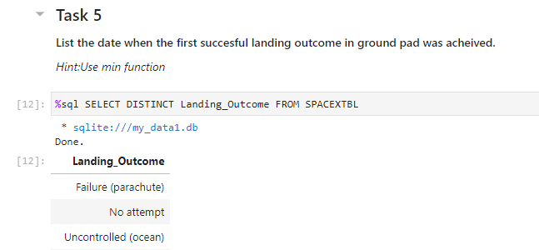
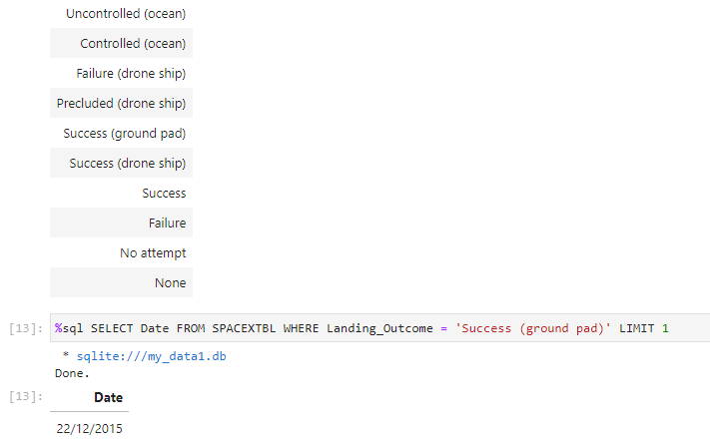
First Successful Ground Landing Date
SQL Queries to first explore the Landing_Outcome and then to find the date where the Landing_outcome is equal to Success in Ground Pad.

Slide 39
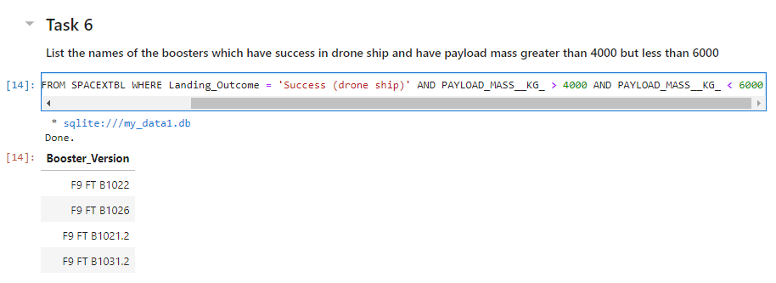
Successful Drone Ship Landing with Payload between 4000 and 6000
SQL Query to find the Booster Version with a Payload Mass between 4000 and 6000 Kg set by the where clauses.

Slide 40
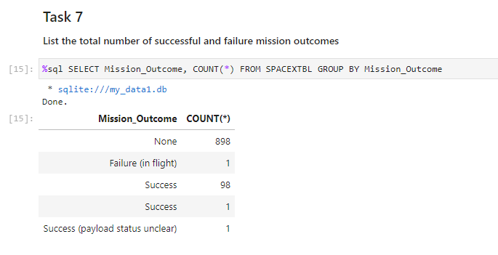
Total Number of Successful and Failure Mission Outcomes
SQL Query to find the number of successful and failure misión outcomes by counting Missing_Outcome.

Slide 41
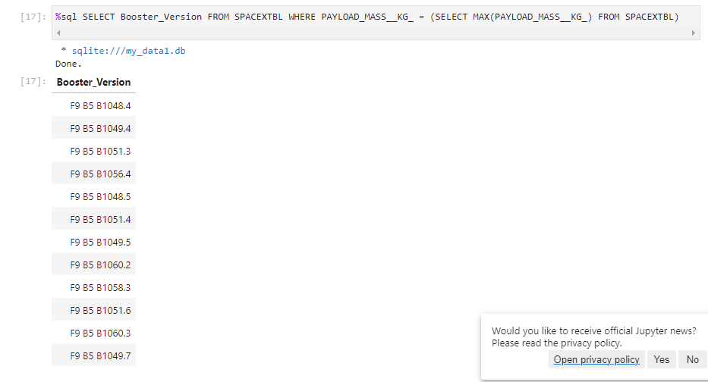
Boosters Carried Maximum Payload
SQL Query with a Subquery that finds the Booster Versions with the Maximum PayLoad_Mass.

Slide 42
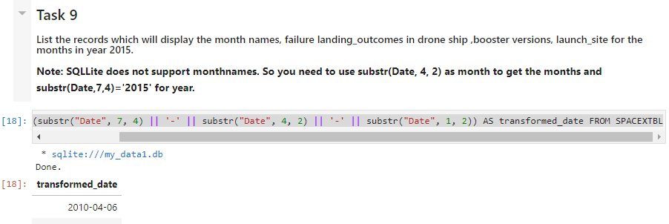
2015 Launch Records
%sql SELECT date(substr("Date", 7, 4) || '-' || substr("Date", 4, 2) || '-' || substr("Date", 1, 2)) AS transformed_date FROM SPACEXTBL

Slide 43
Rank Landing Outcomes Between 2010-06-04 and 2017-03-20
Rank the count of landing outcomes (such as Failure (drone ship) or Success (ground pad)) between the date 2010-06-04 and 2017-03-20, in descending order
Present your query result with a short explanation here

Slide 44

Section 3

Slide 45
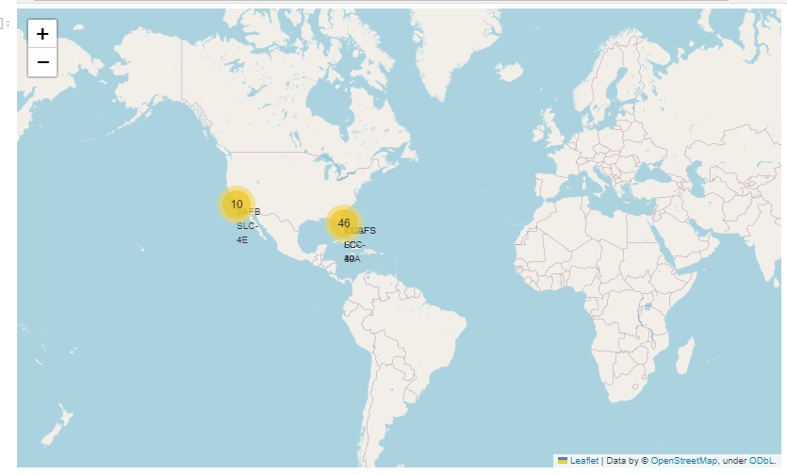
Falcon 9 Launch Locations
The map portrays launch locations on a global map. Note launches are performed on the US East and West coasts.

Slide 46
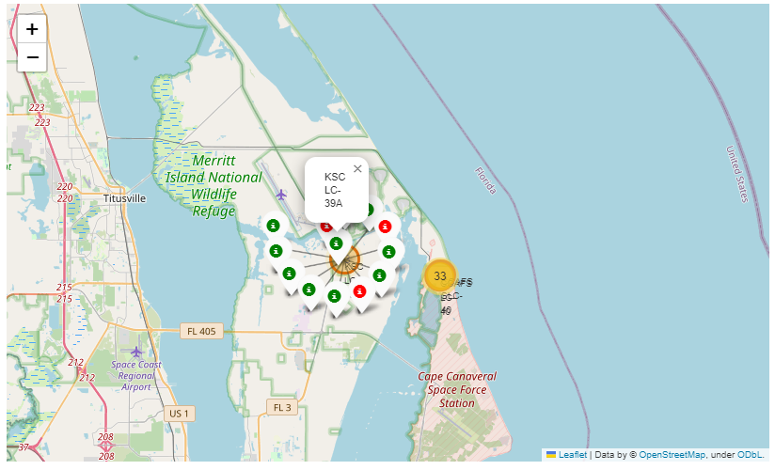
Falcon 9 launches on KSC-LC Location

Slide 47
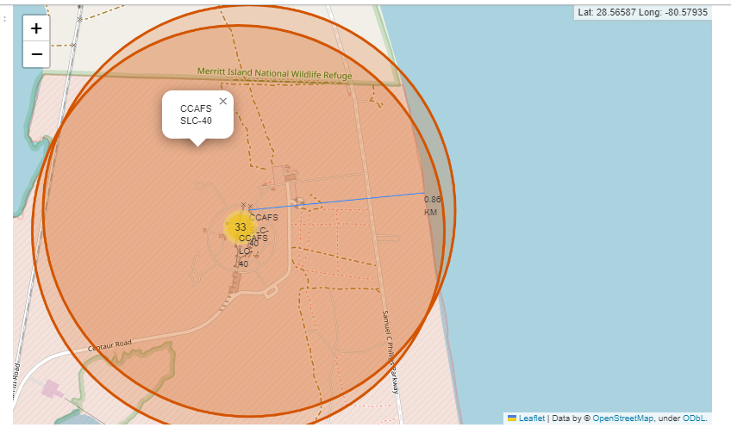
CCAFS SLC -40 Location with distances to coastlines
Folium map on selected site with lines displaying distances in KM to coastline.

Slide 48

Section 4

Slide 49
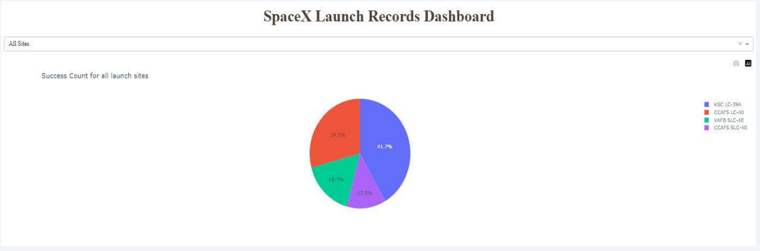
SpaceX Launch Records - Dashboard
Replace <Dashboard screenshot 1> title with an appropriate title
Show the screenshot of launch success count for all sites, in a piechart
Explain the important elements and findings on the screenshot
Launch site KSC LC has the highest launch success rate at 42% followed by CCAFS LC with 29%, VAFB SLC with 17% and lastly launch site CCAFS SLC with a success 13%

Slide 50
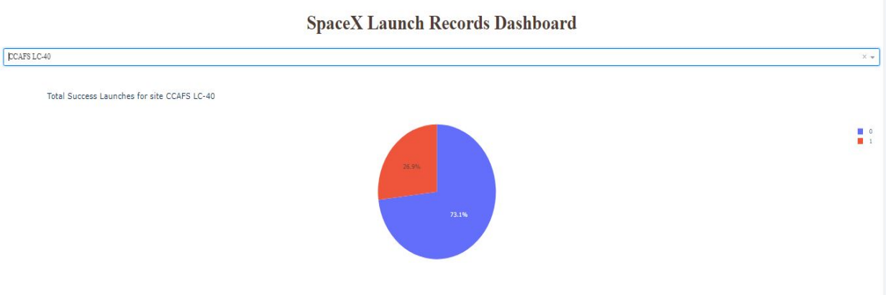
SpaceX Launch Records - Dashboard
Replace <Dashboard screenshot 2> title with an appropriate title
Show the screenshot of the piechart for the launch site with highest launch success ratio
Explain the important elements and findings on the screenshot
• Launch site CCAFS LC had a success ratio of 73%

Slide 51
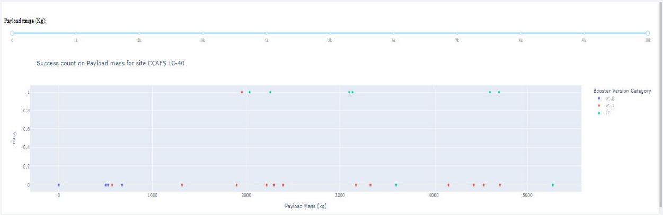
Success per Booster on selected Site
Replace <Dashboard screenshot 3> title with an appropriate title
Show screenshots of Payload vs. Launch Outcome scatter plot for all sites, with different payload selected in the range slider
Explain the important elements and findings on the screenshot, such as which payload range or booster version have the largest success rate, etc.
The graph displays the success count of three different Booster Versions with different Payload Masses on launch site CCAFS LC-40

Slide 52

Section 5

Slide 53
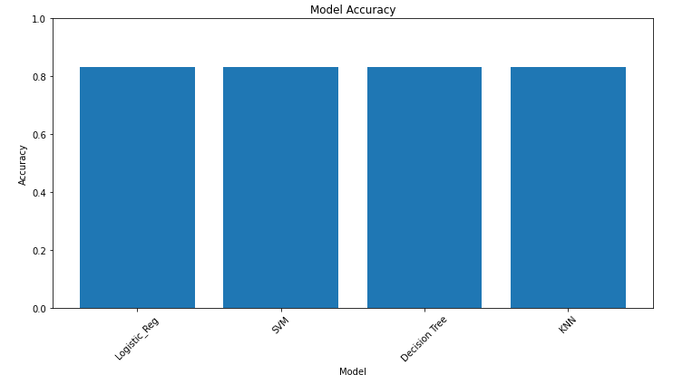
Classification Accuracy
All models share the same accuracy with a value of 83.33% accuracy.

Slide 54
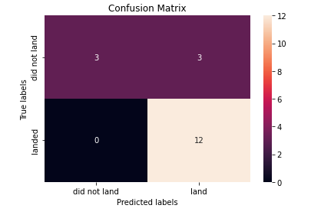
Confusion Matrix
All models present the same confusion Matrix which shows there is an incidence of false positives, but accuracy is set at 83.33% as shown in the previous slide.

Slide 55
Conclusions
Launch sites have varying success rates, with CCAFS LC-40 at 60%, and KSC LC-39A and VAFB SLC 4E at 77%.
Success rates tend to increase as the flight number rises at each launch site, notably reaching 100% for VAFB SLC 4E after the 50th flight and for KSC LC 39A and CCAFS SLC 40 after the 80th flight.
VAFB-SLC launch site has no recorded rocket launches for heavy payload masses exceeding 10,000.
Orbits ES-L1, GEO, HEO, and SSO have a perfect 100% success rate, while SO orbit has the lowest success rate at approximately 50%, with 0% success.
In LEO orbit, success appears related to the number of flights, whereas in GTO orbit, there is no clear relationship between flight number and success.
For heavy payloads, positive landing rates are higher in Polar, LEO, and ISS orbits, but distinguishing this in GTO is challenging as both positive and negative landing outcomes exist.
Finally, the success rate has been steadily increasing since 2013, reaching its peak in 2020.

Slide 56
Appendix
URL to GitHub Repository:
https://github.com/Alejandro-ER/ibm_capstone_project

Slide 57


